Slide 1

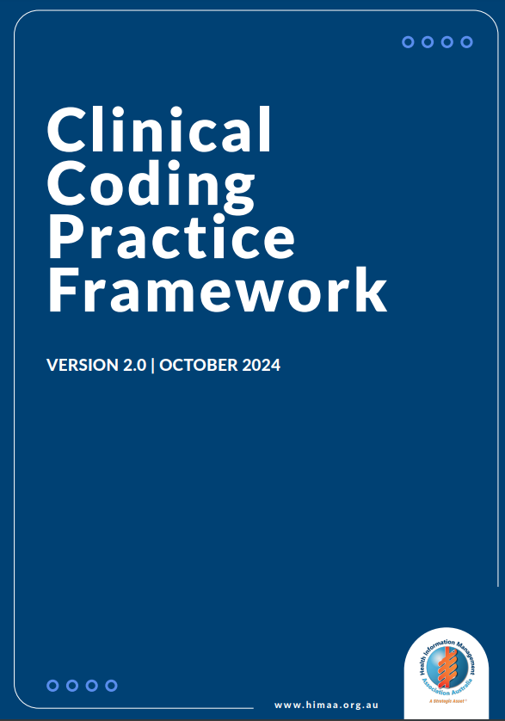
Version 2
Clinical Coding Practice Framework
Slides to support implementation
James Katte CHIM CHIA
Chair, HIMAA Clinical Coding Task Force
Notes:
The Clinical Coding Practice Framework is published by HIMAA
Version 2.0 was published in October 2024 after public consultation with the industry

Slide 2
Using these slides
These slides may be used to support workforce education or orientation
Content can be embedded into processes or policies
Use of these slides and other content from the Clinical Coding Practice Framework must be acknowledged using the appropriate attribution
Suggested attribution
Clinical Coding Practice Framework – October 2024
Clinical Coding Practice Framework © 2024 by Health Information Management Association of Australia is licensed under Creative Commons Attribution-NonCommercial-ShareAlike 4.0 International
Notes:
These slide may be used by members of the workforce in the local implementation of the Framework
Attribution is how health services can ensure they meet the requirements under the Creative Commons licence

Slide 3
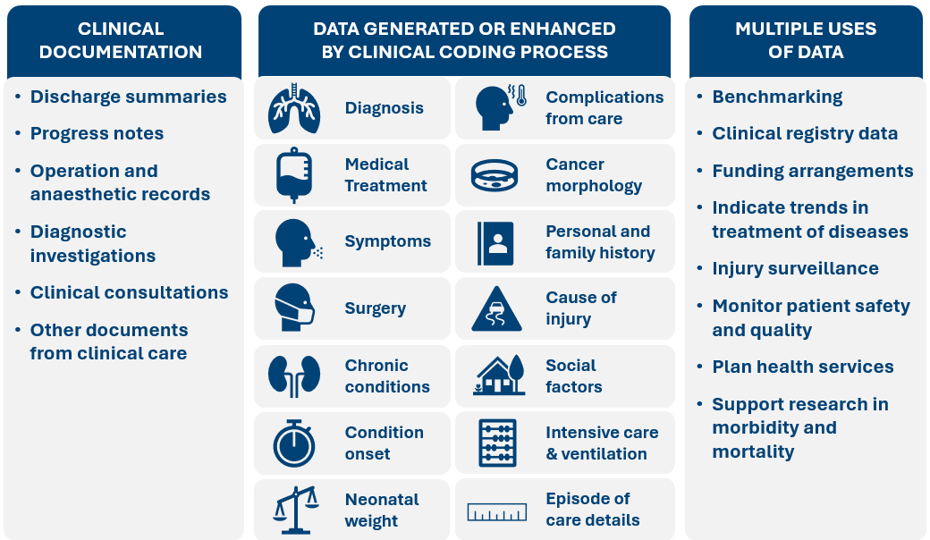
Clinical coding process inputs and outputs
Notes:
The clinical coding process uses clinical documentation of conditions treated, investigated or requiring other clinical care to produce high-quality data that can be used by health services, health departments, national government agencies, researchers and funders of private health

Slide 4
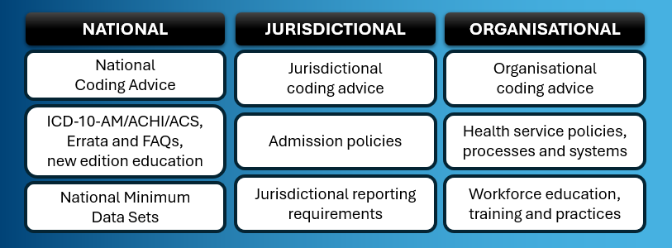
Factors related to the clinical coding process
Notes:
Certain factors influence clinical coded data at the national, jurisdictional and health service/organisational level. These factors work together to ensure clinical coded data is consistently reported at the national level but may differ at jurisdictional or organisational (health service or health network) levels to enable local priorities to be captured without influencing nationally collected data.

Slide 5
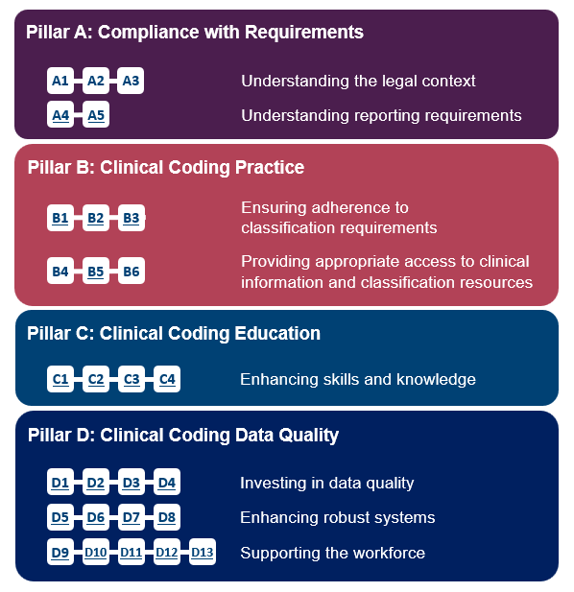
Pillar requirements
Description: Pillars outline the requirements (such as policies, systems and processes) for health services to put into place in their role as workplaces supporting the clinical coding process.
Structure: Requirements are grouped into themes under each pillar. The Framework has:
  4 pillars: A, B, C and D
  8 themes that group
  requirements together
Notes:
The Pillar requirements introduce the systems approach to supporting good practice in the clinical coding process
There are 28 requirements in total, spread across 8 themes and 4 pillars
References are used in the Framework (e.g. A, B, C, D for Pillars; A2, B3, D13 for Requirements) to enable consistency in describing the policies, systems and procedures that a health service uses to support the workforce

Slide 6
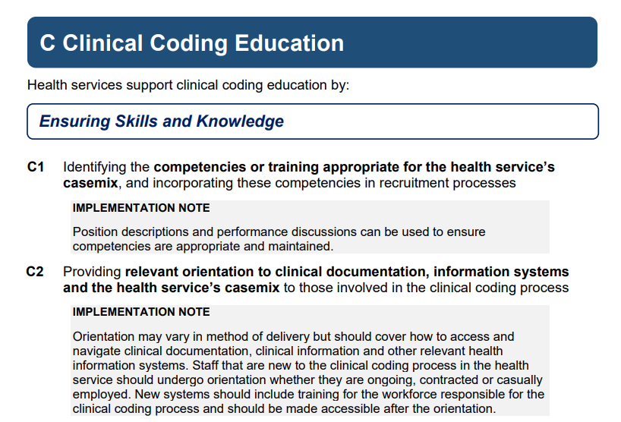
The structure of the requirements
Pillar
Theme
Reference
Implementation note
Requirement
Notes:
The Pillar requirements have structures to support understanding and clarity:
Pillars are the highest level of the requirements – they have references of a single letter (e.g. A, B…)
Themes are the next level of the requirements, they have no references but are useful in grouping together two or more requirements. They are written in reference to supporting the pillar. For the example on this slide “Health services support clinical coding education by:” + “Ensuring Skills and Knowledge”
Requirements describe the policies, systems and procedures required to support the workforce – they have references of a letter and a number (e.g. A2, C3, D10). Requirements also have implementation notes that provide context.

Slide 7
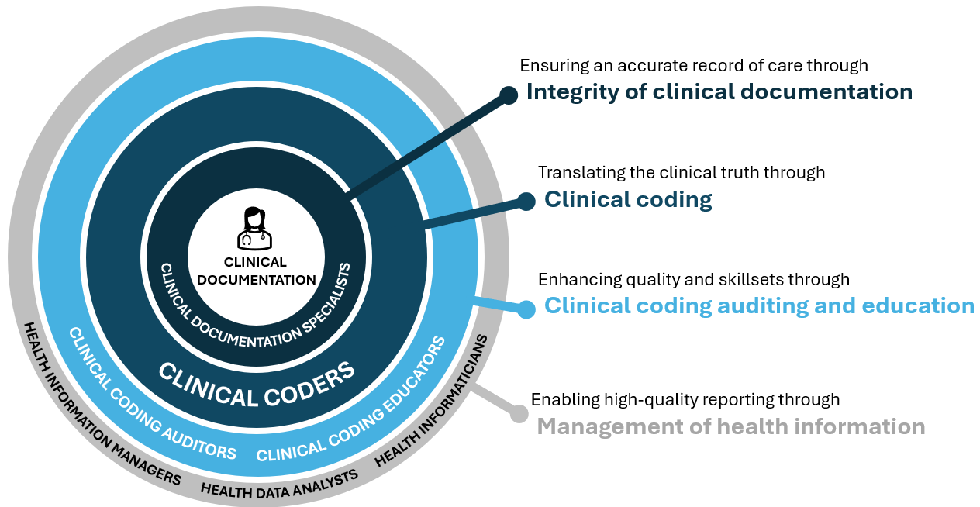
Stages of the clinical coding process
Notes:
The clinical coding process can be broken down into 4 main stages
The diagram shows the typical workforce involved in each stage – the Pillar requirements require health services to determine the roles, responsibilities, qualifications and training required to undertake the stages
Health services may determine that a role covers one or more of these stages

Slide 8
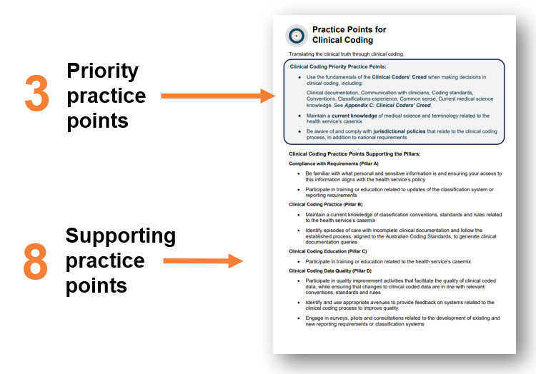
Practice points
Description: Practice points focus the workforce involved in the four stages of the clinical coding process.
Structure: Each stage of the clinical coding process has:
  3 priority practice points, the focus areas for achieving good practice
  8 supporting practice points, one for each theme
Notes:
Practice points guide the workforce in good practice
There are two types of practice points for each stage of the clinical coding process:
Priority practice points – the workforce should be very familiar with and apply these practice points
Supporting practice points – the workforce should recognise and understand these practice points

Slide 9
STAGE 1
Practice Points for the Integrity of clinical documentation
Ensuring an accurate record of care through integrity of clinical documentation.
Integrity of clinical documentation priority practice points:
Use clinical documentation reviews to identify opportunities to support documented communication between clinicians, identification of safety and quality issues and enhance the clinical coding process
Use established guidelines when formulating clinical documentation queries
Facilitate the connection between clinicians and those responsible for the clinical coding process to support upskilling
1

Slide 10
STAGE 1
Practice Points for the Integrity of clinical documentation
Ensuring an accurate record of care through integrity of clinical documentation.
Integrity of clinical documentation practice points supporting the pillars:
Compliance with Requirements (Pillar A)
Be familiar with what personal and sensitive information is and ensuring access to this information aligns with the health service’s policy
Incorporate the appropriate updates to reporting requirements and classification changes when undertaking clinical documentation improvement activities
Clinical Coding Practice (Pillar B)
Seek clarification on conventions, standards and rules of the classification system from those responsible for clinical coding
Support the processes established by the health service to generate relevant, accurate and complete clinical documentation
Clinical Coding Education (Pillar C)
Engage and support relevant education activities related to the clinical coding process, clinical updates related to the health service’s casemix and clinical documentation improvement/integrity
Clinical Coding Data Quality (Pillar D)
Use a quality improvement approach in addressing clinical documentation improvement and integrity
Contribute to enhancements in systems, forms and processes when a health service is undertaking change processes
Organise opportunities for clinicians and the workforce involved in the clinical coding process to exchange knowledge
1

Slide 11
STAGE 2
Practice Points for Clinical Coding
Translating the clinical truth through clinical coding.
Clinical coding priority practice points:
Use the fundamentals of the Clinical Coders’ Creed when making decisions in clinical coding, including:
Clinical documentation, Communication with clinicians, Coding standards, Conventions, Classifications experience, Common sense, Current medical science knowledge.
See Appendix C: Clinical Coders’ Creed.
Maintain a current knowledge of medical science and terminology related to the health service’s casemix
Be aware of and comply with jurisdictional policies that relate to the clinical coding process, in addition to national requirements
2

Slide 12
STAGE 2
Practice Points for Clinical Coding
Translating the clinical truth through clinical coding.
Clinical coding practice points supporting the pillars:
Compliance with Requirements (Pillar A)
Be familiar with what personal and sensitive information is and ensuring your access to this information aligns with the health service’s policy
Participate in training or education related to updates of the classification system or reporting requirements
Clinical Coding Practice (Pillar B)
Maintain a current knowledge of classification conventions, standards and rules related to the health service’s casemix
Identify episodes of care with incomplete clinical documentation and follow the established process, aligned to the Australian Coding Standards, to generate clinical documentation queries
Clinical Coding Education (Pillar C)
Participate in training or education related to the health service’s casemix
Clinical Coding Data Quality (Pillar D)
Participate in quality improvement activities that facilitate the quality of clinical coded data, while ensuring that changes to clinical coded data are in line with relevant conventions, standards and rules
Identify and use appropriate avenues to provide feedback on systems related to the clinical coding process to improve quality
Engage in surveys, pilots and consultations related to the development of existing and new reporting requirements or classification systems
2

Slide 13
STAGE 3
Practice Points for Clinical coding auditing and education
Enhancing quality and skillsets through clinical coding auditing and education.
Clinical coding auditing and education priority practice points:
Use quality assurance activities or monitoring of data quality to determine education and auditing priorities
Audit and educate on the data generated or enhanced by the clinical coding process using clinical knowledge and medical science to support a foundation of understanding
Ensure education supports an understanding of the health service’s casemix and systems with a focus on the conventions, standards and rules of the classification, incorporating relevant content from updates to conventions, standards and rules
3

Slide 14
STAGE 3
Practice Points for Clinical coding auditing and education
Enhancing quality and skillsets through clinical coding auditing and education.
Clinical coding auditing and education practice points supporting the pillars:
Compliance with Requirements (Pillar A)
Be familiar with what personal and sensitive information is and ensuring your access to this information aligns with the health service’s policy
Identify auditing and education priorities related to the health service’s casemix including updates to the classification system or reporting requirements
Clinical Coding Practice (Pillar B)
Promote and monitor the use of established processes to address and resolve disputes on code assignment
Ensure the processes, templates and generation of clinical documentation queries are in line with established guidelines
Clinical Coding Education (Pillar C)
Assist in developing materials relevant to navigating clinical documentation, updates in information systems and changes in the health service’s casemix
Clinical Coding Data Quality (Pillar D)
Undertake audits that align with relevant conventions, standards and rules of the classification system, and ensure a balanced focus of topics that include safety and quality reporting and other areas of importance for jurisdictions or organisations
Monitor the quality assurance processes of newly implemented systems to ensure they are performing as intended
Identify relevant education opportunities where the workforce responsible for the clinical coding process and clinicians can exchange knowledge
3

Slide 15
STAGE 4
Practice Points for the Management of health information
Enabling high-quality reporting through management of health information.
Management of health information priority practice points:
Interpret and report clinical coded data with expert advice from those involved in the clinical coding process from the health service
Align systems and data quality processes with the conventions, standards and rules of the classification requirements
Consult those performing the clinical coding process in the health service when designing new systems to support the clinical coding process
4

Slide 16
STAGE 4
Practice Points for the Management of health information
Enabling high-quality reporting through management of health information.
Management of health information practice points supporting the pillars:
Compliance with requirements (Pillar A)
Support the monitoring of access to personal and sensitive information in line with the health service’s policy
Review systems on an established basis to ensure they are aligned with current reporting requirements
Clinical Coding Practice (Pillar B)
Ensure that data quality edits and validations are aligned with conventions, standards and rules of the classification system
Ensure that appropriate information systems are accessible to the workforce responsible for the clinical coding process, with access to the relevant information within those systems
Clinical Coding Education (Pillar C)
Identify updates to reporting requirements or the classification system and educate the workforce of the related changes to clinical documentation to collect this information
Clinical Coding Data Quality (Pillar D)
Identify routine quality improvement activities that aim to improve the quality of clinical coded data
Participate in projects or working groups related to new systems that impact the clinical coding process
Identify the priority areas in clinical coded data to support clinicians improving their clinical documentation and clinical care through quality improvement activities
4

